Slide 1
Files I/O

Slide 2
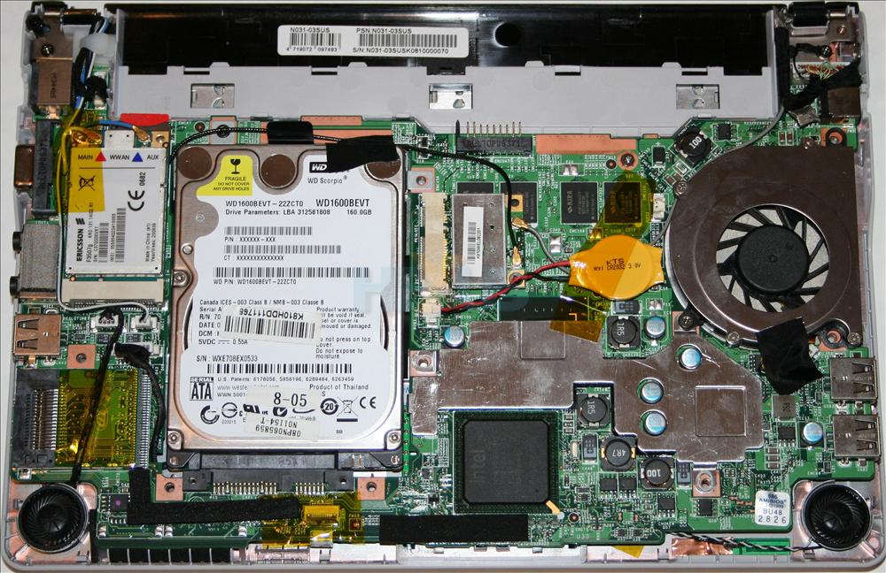

Slide 3
What is a file?
A file is a location on the computer’s disk to permanently store data. The location on the disk is in a non-volatile memory.
open() | I/O
read()
write()
close()
Census Data
New York
8,622,698
Los Angeles
3,999,759
Chicago
2,716,450
Houston
2,312,717
Program
Disk space

Slide 4
Files I/O: text files
A text file only contains text and no special formatting such as bold text, italic text, images, etc.
A character can be:
numbers: 1, 3, 6, ...
letters: M, p, y, t, ...
non-alphanumeric symbols: #, $ ...
other symbols: 汉, Й ...
In text files, lines are broken up by special invisible characters that mark end of lines.
Invisible characters like these are called control characters.
In Python the end of the line character is \n.

Slide 5
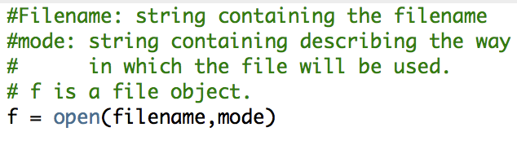
Files I/O: open()
The open() function creates a file object (a way of getting at the contents of the file).
The file object is also called a handle, it is used to read or write to the file.
filename is the path the file.
mode is the file system permission.

Slide 6
Files I/O: modes
Modes are the file system permissions given to a user to access a file.
Mode | Description
'r' | open for reading (default)
'w' | open for writing, truncating the file first
'x' | open for exclusive creation, failing if the file already exists
'a' | open for writing, appending to the end of the file if it exists
'b' | binary mode
't' | text mode (default)
'+' | open a disk file for updating (reading and writing)

Slide 7
Files I/O: modes
' r' Open file for reading. The stream is at the beginning of the file.
'r+' Open for reading and writing. The stream is at the beginning of the file.
'w' Truncate file to size zero or create a new file. The stream is at the beginning of the file.
'w+' Open for reading and writing. The file is created if it does not exist, otherwise it is truncated. The stream is at the beginning of the file.
'a' Open for writing. The file is created if it does not exist. The stream is at the end of the file.
'a+' Open for reading and writing. The file is created if it does not exist. The stream is at the end of the file.

Slide 8
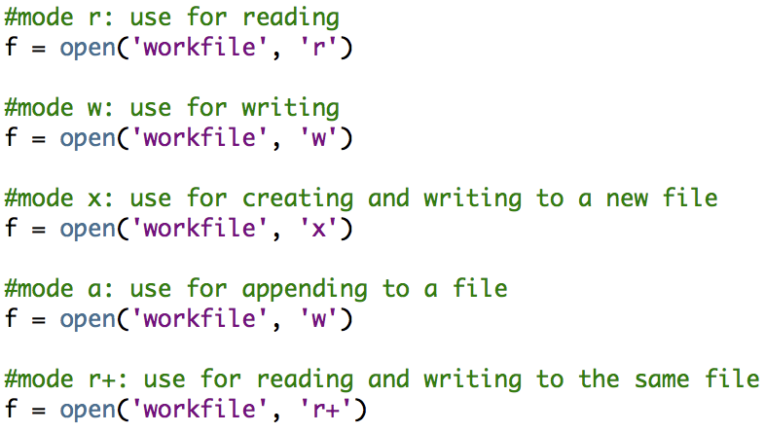
Files I/O: text files
'a'
Notes:
Open a file
Read or write (perform operation)
Close the file

Slide 9
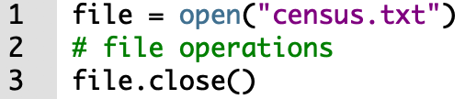
Files I/O: close()
Remember to close!
When the operations on the file are done, close the file.
Closing a file frees up the resources that were tied with the file.

Slide 10

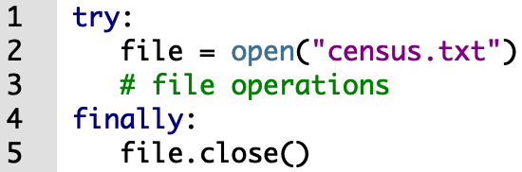
Files I/O: exception handling
An exception is an event, that occurs during the execution of a program.
If an exception occurs, the code exits without closing the file.
Here is a better way. Do this instead:

Slide 11
Files I/O: exception handling
When exceptions occurs, the program execution stops until it is handled.
If the exception is not handled, the program crashes!
The try statement:
In Python, similar to some other programming languages, exceptions are handled using the try statement.
try: # do something except: | try: # do something finally:

Slide 12
Files I/O: exception handling
Even better exception handling!
The with statement:
We can use the with statement for exception handling.
with open(“census.txt”) as file:
content = file.read()
do something with content
What do you notice when using the with statement?

Slide 13
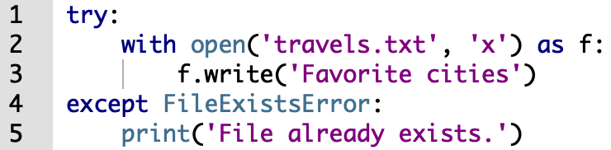
Files I/O: exception handling
If we open a file in mode x, the file is created and opened for writing, only if it does not exist.
If the file exists we get a FileExistsError.
We can catch and handle this error:

Slide 14
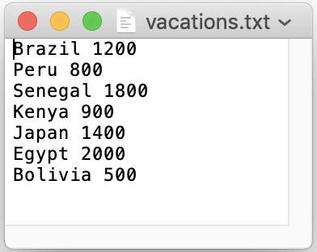
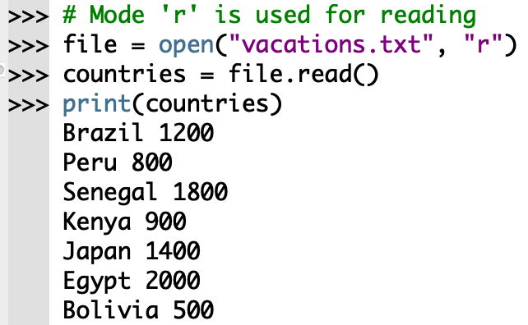
Files I/O: read()
<file>.read() returns the entire contents of the file as a single string.
File content
<file>.read()

Slide 15
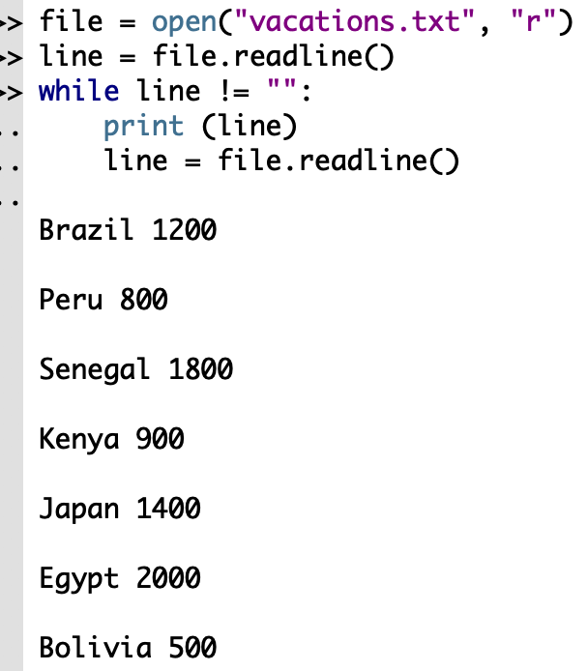
Files I/O: readline()
<file>.readline() returns the next line of the file, returning the text up to and including the next newline character.
This operation reads a file line-by-line.
File content
<file>.readline()

Slide 16
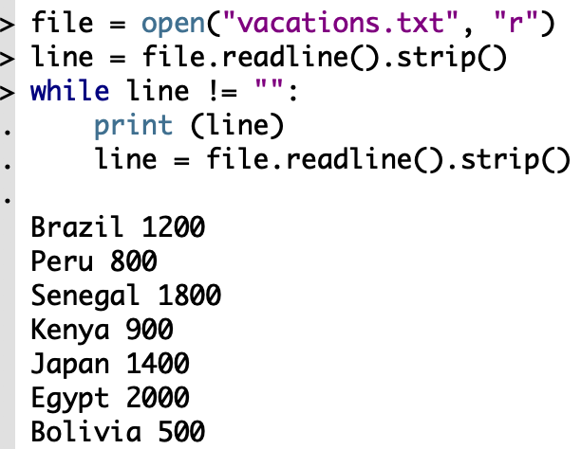
Files I/O: readline().strip()
The .strip() method removes the extra newline characters.
File content
<file>.readline().strip()

Slide 17
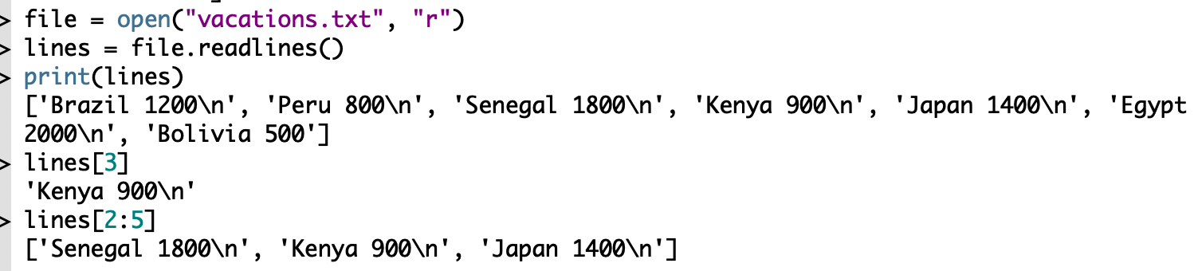
Files I/O: readlines()
<file>.readlines() reads all the lines of a file and saves them into a list.

Slide 18
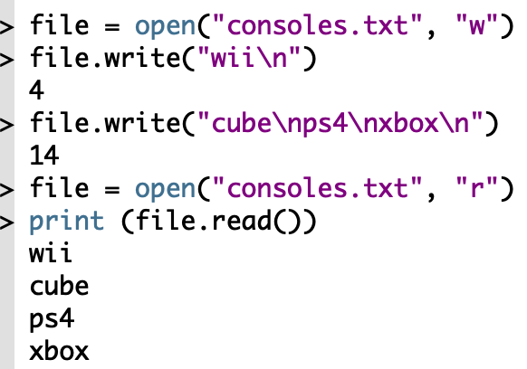
Files I/O: write()
<file>.write() writes new contents to a file.
Warning: .write() overwrites the previous content of the file!

Slide 19
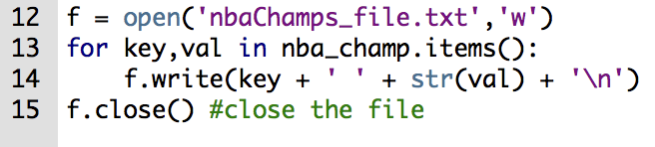
Files I/O: write()
There is one important difference between print()and write()
print() automatically ends the line.
write() does not automatically end the line.
To end the line we add the newline character \n manually.

Slide 20
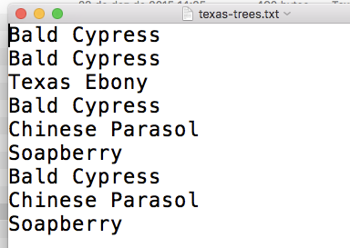
Files and Dictionaries
A text file contains the names of Texas trees.
Write a program that performs the following:
Read the names of the trees from the file
Count the types of trees and write the results in a new file
Sort the trees by alphabetical order and write the results in a new file

Slide 21
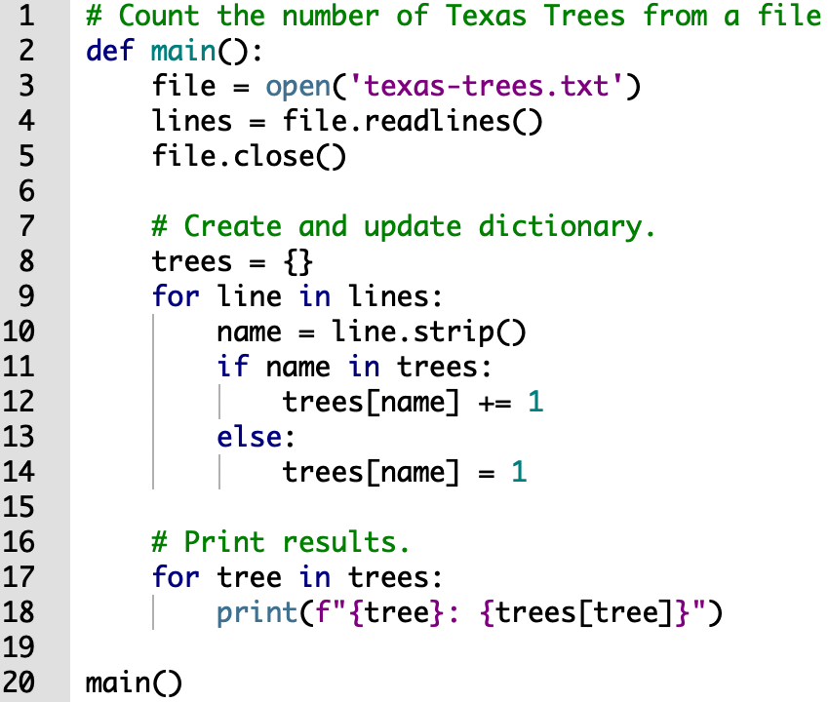
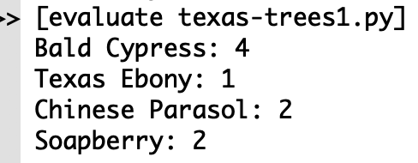
Files and Dictionaries

Slide 22
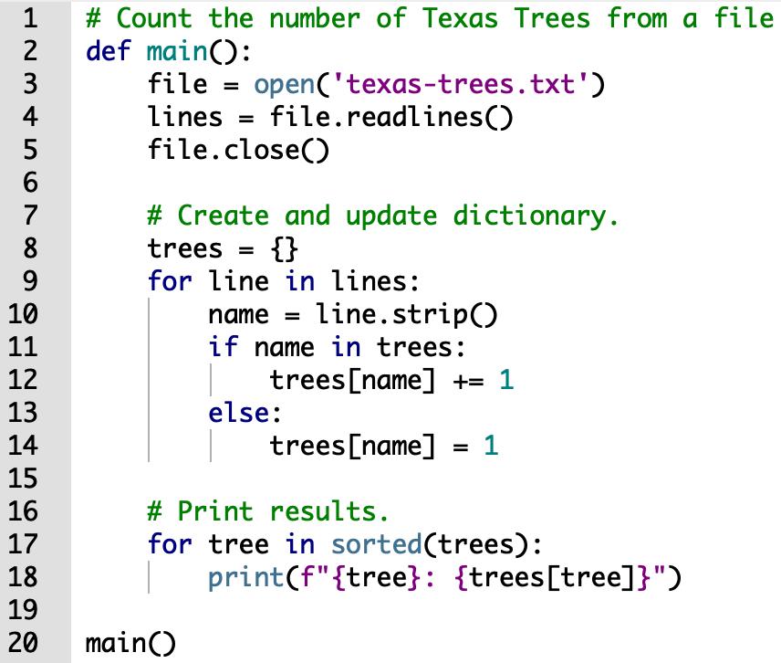
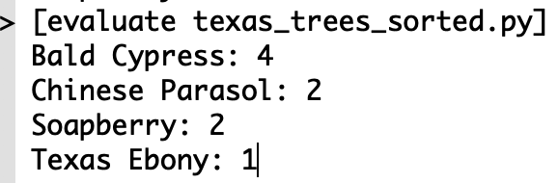
Files and Dictionaries

Slide 23
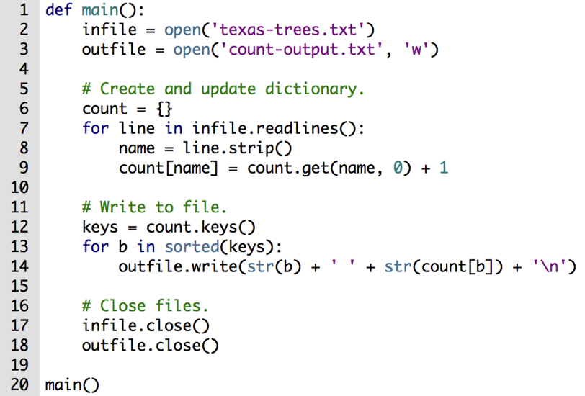
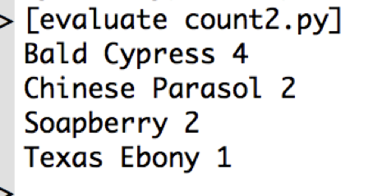
Files and Dictionaries

Slide 24
Files I/O: methods
Method | Description
close() | Close an open file. It has no effect if the file is already closed.
detach() | Separate the underlying binary buffer from the TextIOBase and return it.
fileno() | Return an integer number (file descriptor) of the file.
flush() | Flush the write buffer of the file stream.
isatty() | Return True if the file stream is interactive.
read(n) | Read at most n characters form the file. Reads till end of file if it is negative or None.
readable() | Returns True if the file stream can be read from.
readline(n=-1) | Read and return one line from the file. Reads in at most n bytes if specified.
readlines(n=-1) | Read and return a list of lines from the file. Reads in at most n bytes/characters if specified.

Slide 25
Files I/O: methods
seek(offset,from=SEEK_SET) | Change the file position to offset bytes, in reference to from (start, current, end).
seekable() | Returns True if the file stream supports random access.
tell() | Returns the current file location.
truncate(size=None) | Resize the file stream to size bytes. If size is not specified, resize to current location.
writable() | Returns True if the file stream can be written to.
write(s) | Write string s to the file and return the number of characters written.
writelines(lines) | Write a list of lines to the file.

